Slide 1
Faulhaber Controller
Subtitle

Slide 2
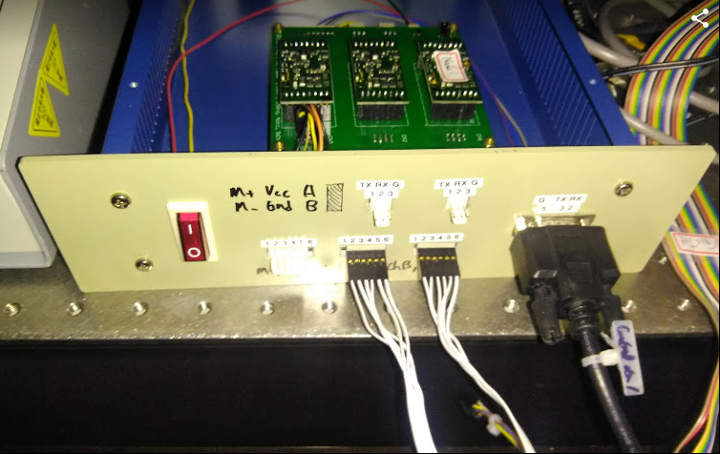
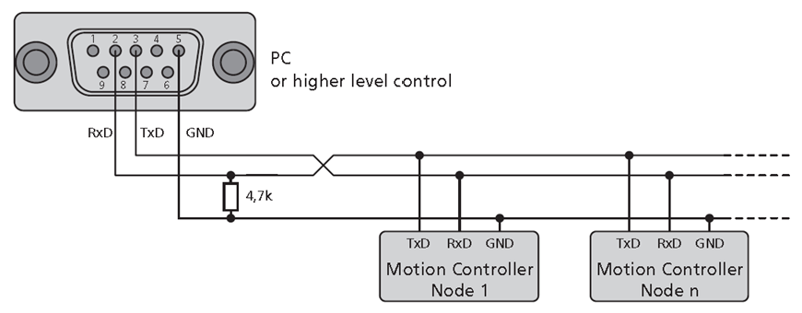
Pin Scheme Of Controller
RS232, D9 female
m+ | Vcc | A
m- | Gnd | B

Slide 3
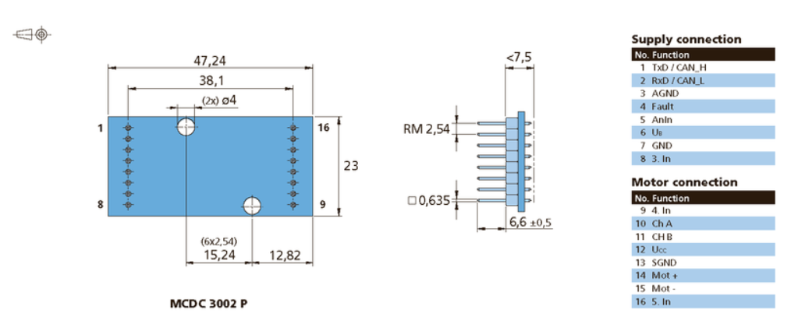
Faulhaber Controller Pin

Slide 4
Pin Scheme Of PCB

Slide 5
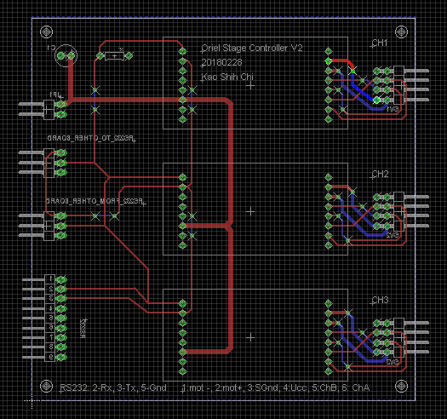
PCB Scheme

Slide 6
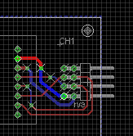
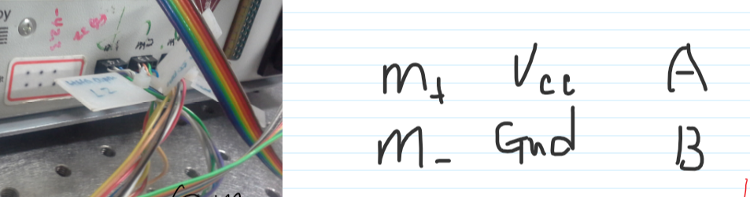
Pin Of Stage Connector
B | A
Gnd | Vcc
m- | m+

Slide 7
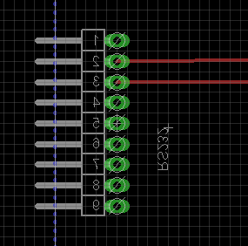
Pin Of RS232 Connector
Rx
Tx
Gnd

Slide 8
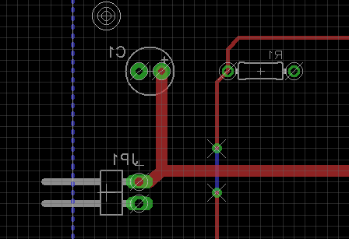
Pin Of +12 Power
1 uF
4.7 k Ohm
+12 V, DC
Gnd

Slide 9
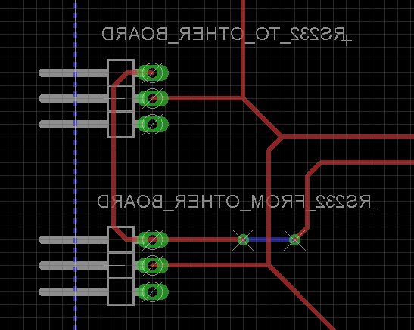
Pin Of Communication
Tx
Rx
Gnd

Slide 10
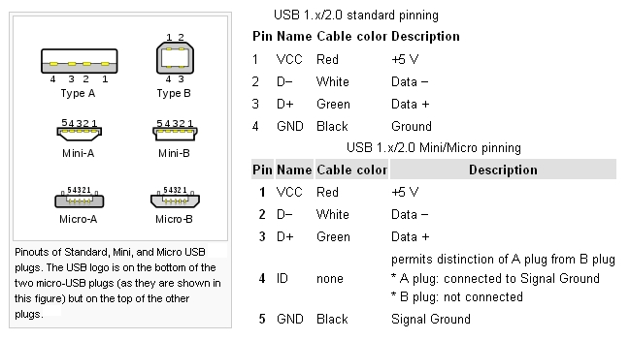
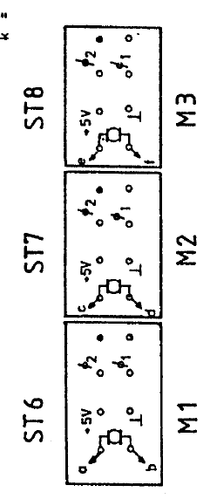

Slide 11
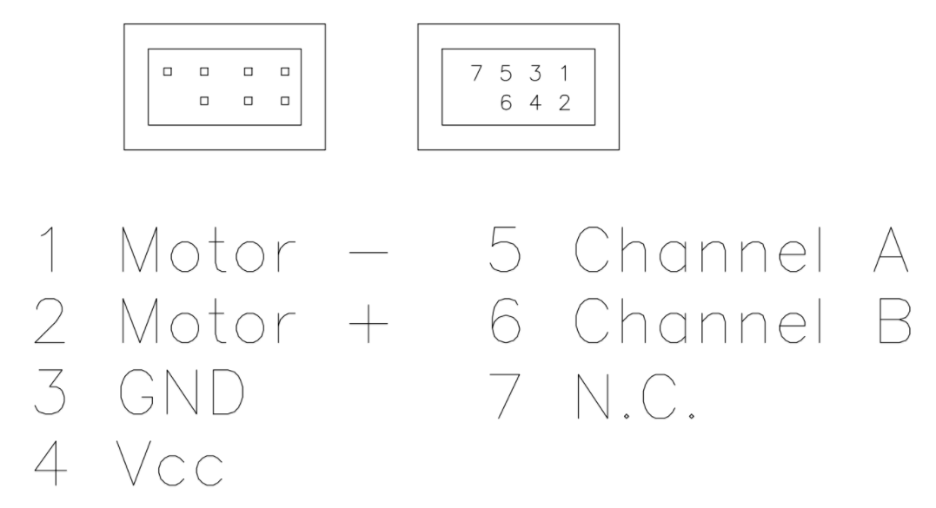
To actuator
MCDC 3002
To B
To A

Slide 12
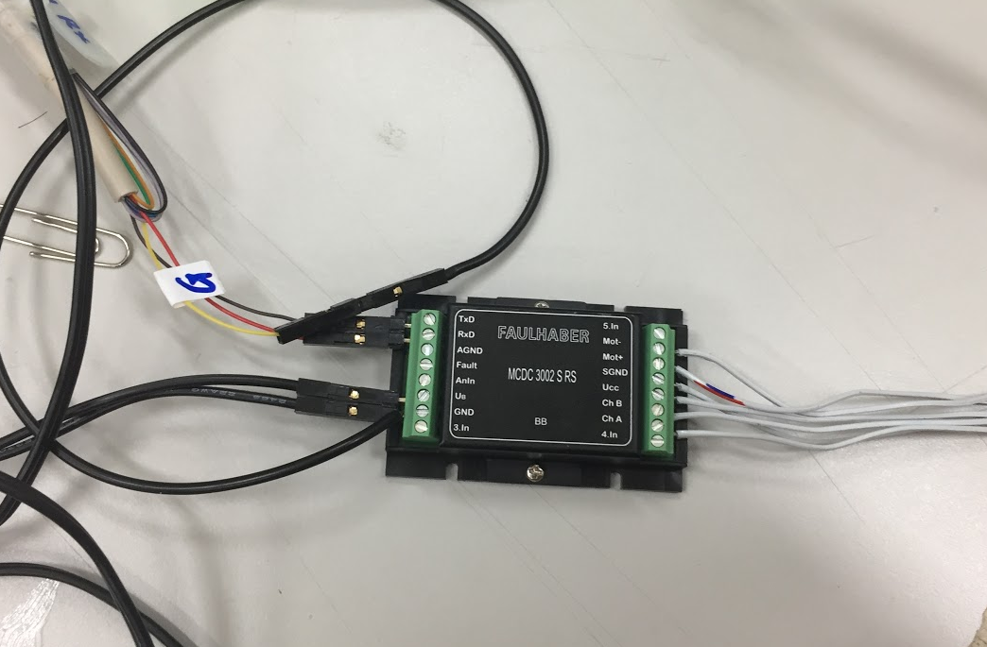
順序如上圖

Slide 13
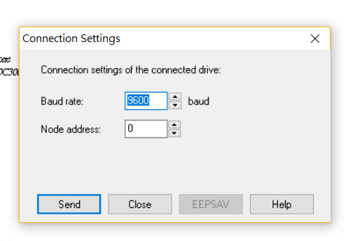
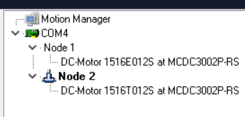
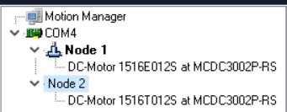

Slide 14

RS232
Red – TxD
Brown – RxD
Yellow - Gnd

Slide 15
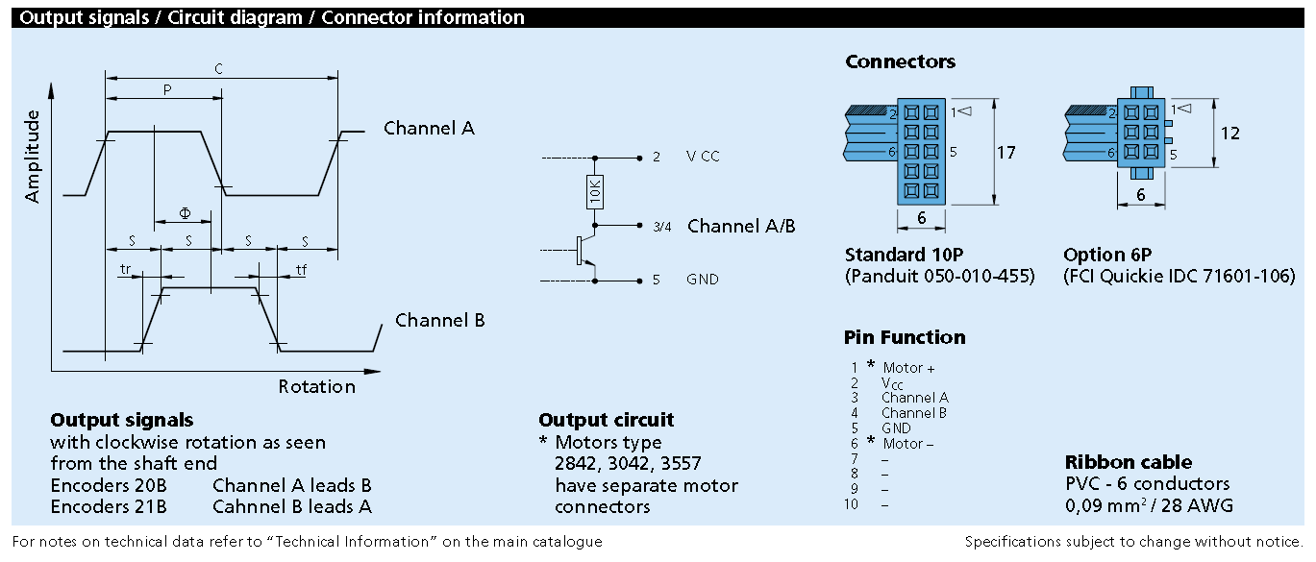

Slide 16
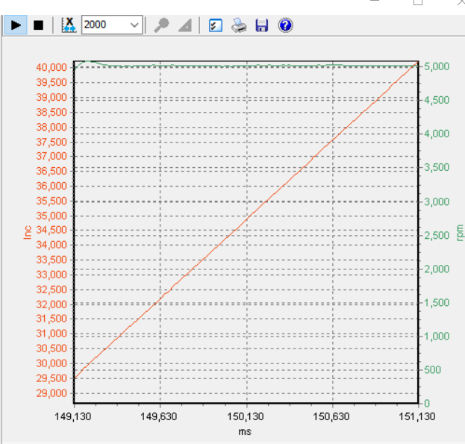
Maximum Speed – 5000 rpm

Slide 17
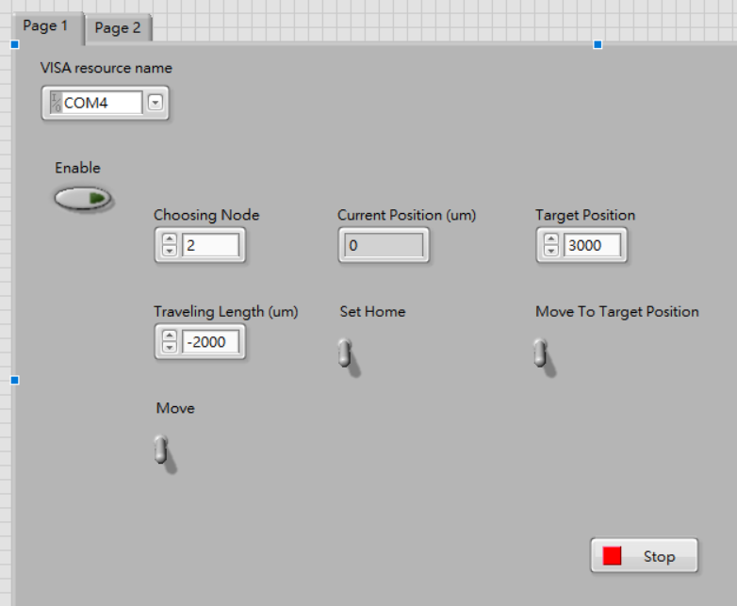

Slide 18
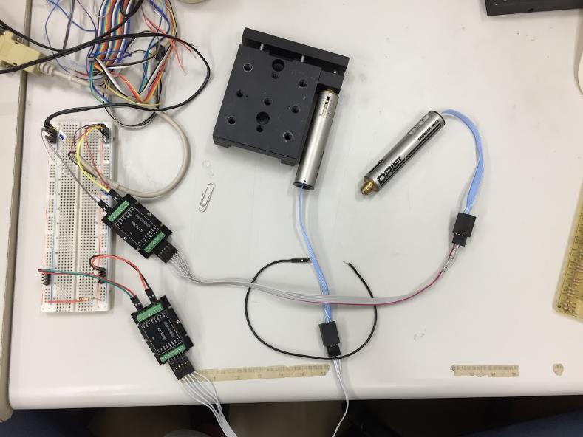

Slide 19
每軸可分開獨立控制
可以中途中斷動作

